Slide 1
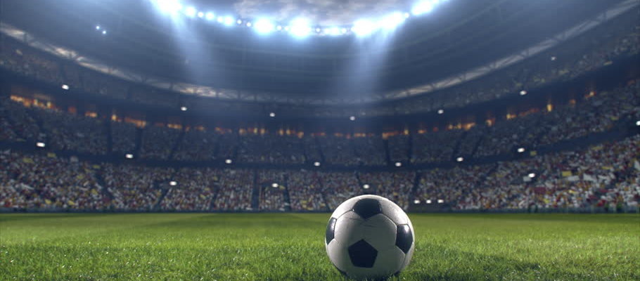
Soccer Notes

Slide 2
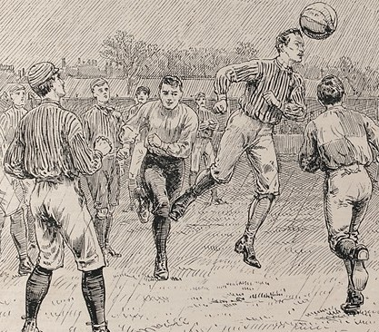
Soccer History
More than 265 million people around the world play soccer regularly
Most popular sport in the world
Records trace the history of soccer back more than 2,000 years ago to ancient China. Greece, Rome, and parts of Central America all claim to have invented soccer.
The English are credited with recording the first uniform rules for the sport
In 1863, the Football Association was formed, which created rules for the game of soccer as we know it today.

Slide 3
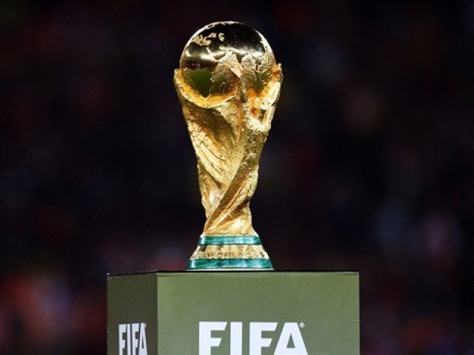
World Cup
The World Cup is a 32 team tournament held every 4 years
The first World Cup was held in 1930
Uruguay won the first tournament
Brazil has won a record, 5 World Cups
USA has been selected to host the 2026 World Cup
The USA Men have never won a World Cup
Women have won 4 times (‘91, ‘99, ‘15, ‘19)
TV Ratings:
98.2 million – number of viewers of Super Bowl in 2019
1.12 billion – number of viewers of World Cup Final in 2018

Slide 4
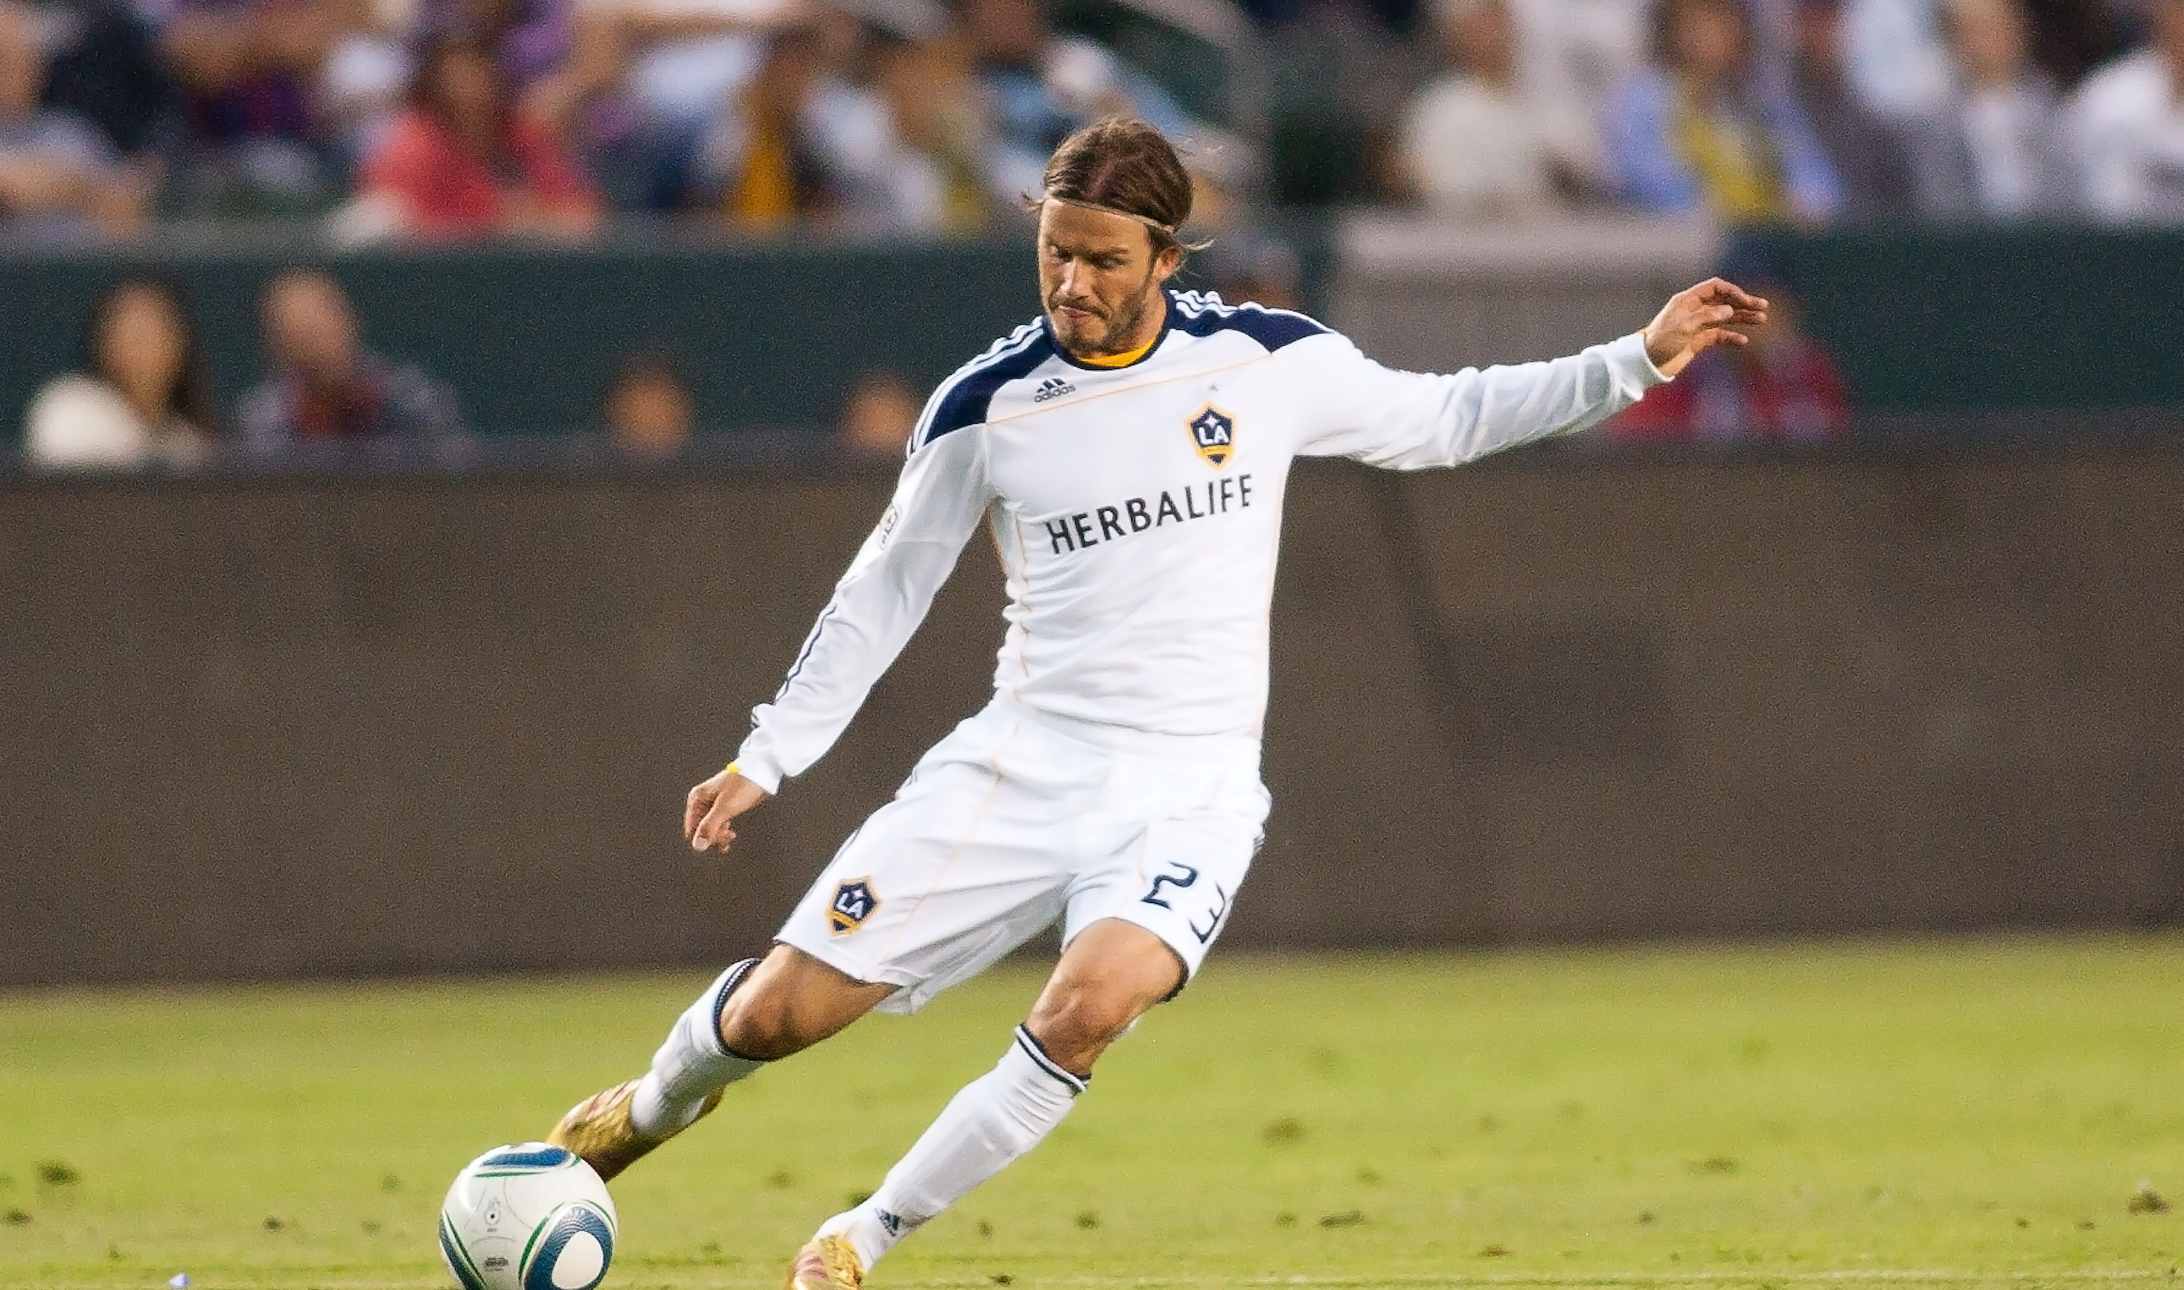
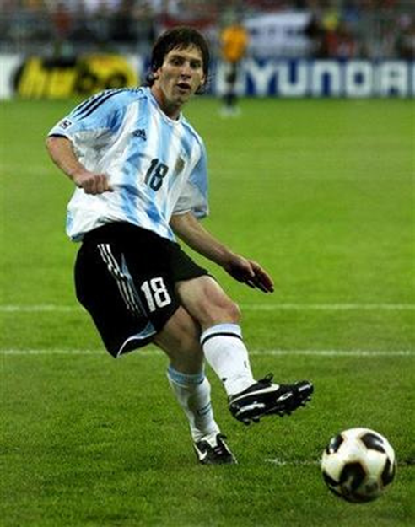
Kicking
Kicking with the laces - mainly used for long passes and shooting (POWER)
Kicking with the inside - mainly used for passing (CONTROL)

Slide 5
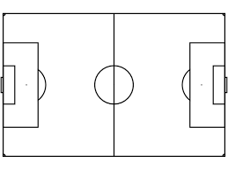
Rules
Handball - a player cannot touch the ball using any part of their arms below the shoulder, unless he/she is playing goalkeeper
Throw-ins – When the ball goes over the sideline and out of bounds
proper throw-ins - have both feet on the ground and throw the ball with both hands over your head
Goal Kick - when the offensive team kicks the ball across their opponents endline
Corner Kick – when the defensive team kicks the ball across their own endline
Sideline
Goal Kicks
Corner
Kicks
Attacking Direction
Endline
Endline

Slide 6
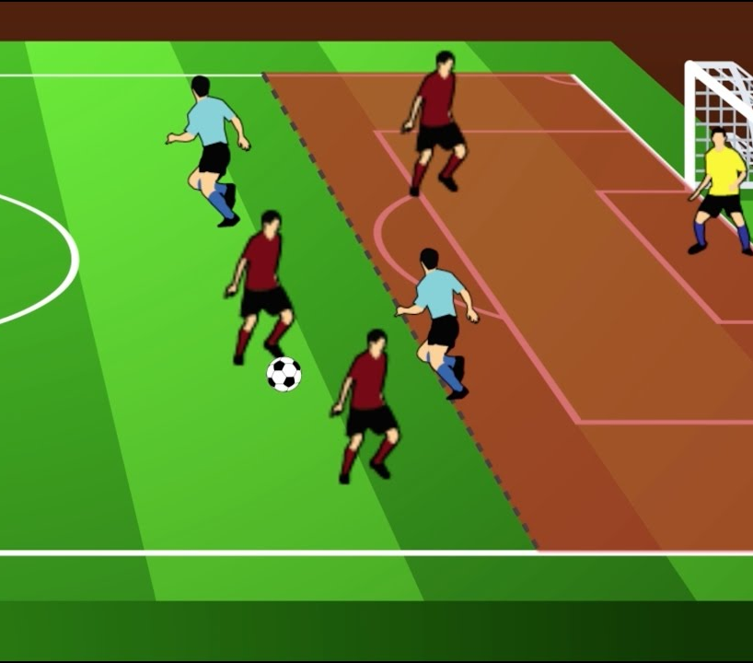
Rules
Attacker - offsides
Offsides - an offensive or attacking player without the ball, cannot be ahead of the ball and involved in the play unless there is a defender between him and the goalkeeper. You can’t just hang out at the other team’s goal.
Last defender

Slide 7
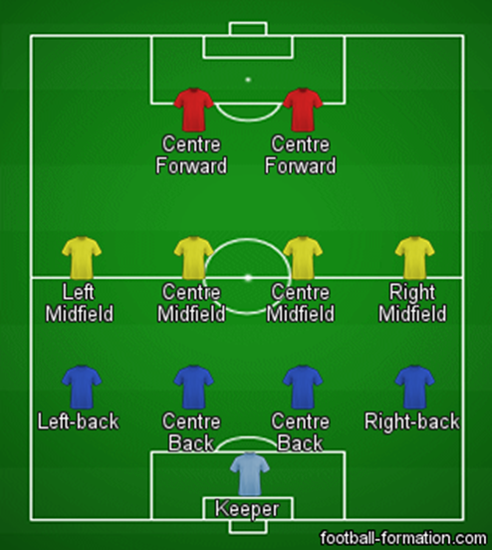
Positions
There are 11 players per team on the field
There are 4 major positions
Goal Keeper – Only player that can use their hands (while inside the penalty box)
Defender – Defensive player that plays close to their own goal. Duty is to stop opposing attackers.
Midfielder – Plays in the center of the field and play both offense and defense
Forwards – Offensive player that plays the furthest forward and takes the most shots at the goal

Slide 8
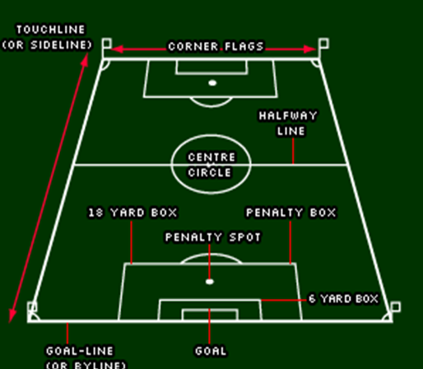
Field Diagram

