Slide 1
Physical Education & Health Syllabus
Mr. Moore &
Mr. mckenzie

Slide 2
Mission Statement
We believe P.E. & Health is a vital component for the development of a student’s physical, mental and social well-being. We hope that through the exposure to a variety of sports and games, as well as gaining an understanding of important health concepts that impact our mind and body, students will develop healthy lifelong habits.

Slide 3
Websites
Students are expected to stay up to date by checking your teacher’s website for important dates and other information.
Students can find:
Test Dates
Activity Log Dates and Instructions
Missed Notes
Instructions for Projects or Assignments
Websites can be found from the Langston Charter Middle School Website OR directly from the following URL’s
Mr. Moore - langstoncharterpemoore.weebly.com
Mr. McKenzie - langstoncharterpemckenzie.weebly.com

Slide 4
Grades
Grading Scale
A = 90-100
B = 80-89
C = 70- 79
D = 60-69
F = 59 or below
Grading Breakdown – We are now on a points system
Class Participation = 100 points per grade (approximately 50% of grade)
Major Grades - Tests, Projects, and Activity Logs= 100 per assignment (approximately 40% of grade)
Minor Grades - Classwork, Homework, Quizzes = 25 or 50 pointes per assignment (approximately 10% of grade)

Slide 5
Grades (Cont.)
Activity Log: Students are responsible for completing activity hours outside the classroom (additional information coming).
Participation: Students are expected to participate in all Physical Education activities unless a medical situation prevents it. Being active is the center of this class, therefore not participating will result in a failing grade for that class period. Exceptions will be made if a parent note or doctor note is provided.
Test/ Quizzes: Tests will be given at the end of each unit. The tests will measure content knowledge on the unit and will largely be based on notes taken in class. Skills tests may be given on activity units
Homework: Homework will not be given on a regular basis. Short assignments may be given.
Extra Credit: Extra credit will not be offered for this class.

Slide 6
Classroom Rules
Students will handle equipment only when instructed to do so. This includes getting a ball out of the ball rack.
Treat the teacher and classmates with respect at all times.
Display good sportsmanship at all times.
Students should enter the gym just like any other classroom. Come in quietly, have a seat, and wait for instructions.
All backpacks are to be kept in the front of the gym as close to the wall as possible (within white boxes).
No students should ever be climbing or hanging on the mats for any reason.
No one should be going to the bathroom without permission.
NO EATING IN THE GYM.

Slide 7
Consequences
Failure to follow these gym rules will result in the following consequences:
Lunch detention.
Sitting out of activities and doing book work.
This will result in a deduction of participation points.
Parent contact.
Being sent out of class.

Slide 8
Students Expectations
My expectations of each student are very high and I will not accept poor quality work or effort.
Students are expected to:
Come to class prepared - Paper, Pencil, Shoes, etc.
Follow the rules and instructions respectfully
Participate to the best of their ability
Let teacher know of your needs

Slide 9
Expectations of Teacher
The teacher can be expected to:
Provide information to students to help them succeed in learning the necessary information for success in my class
Evaluate student progress regularly and adapt learning for student success
Be available for student communication
Include materials that correspond with the state standards listed above.
**Students are expected to communicate with the teacher FIRST before parent contact is made**
The teacher will be at school every day and there are ample opportunities for students to communicate before school, during lunch, or after school.

Slide 10
Emergency Scenarios
Know your exits
Locate Emergency Kits
Locate AED
Never open a door for ANYONE

Slide 11
Activity Logs
Activity Logs will be submitted on Microsoft Teams and will be turned in at home.
No hard copies.
Directions for how to do this will be covered and practiced in class.
Log Guidelines:
Each Activity Log will count as a Major Grade on the report card. Activity Logs count the same as a Major Test grade.
Students will have THREE Activity Logs due each quarter.

Slide 12
Activity Logs
Students are responsible for completing 5 activity hours every three weeks. Hours must be completed within the 3 week period. (No roll over hours)
If Activity Log is turned in late, 10 points will be deducted for each school day it is late (whether you have PE that day or not).
If the activity log is more than 5 days late, it will not be accepted and the student will receive a ZERO for the assignment.
This includes if you were absent from school for some days during this time. This is an online assignment that can be completed from home and due dates are given well in advance so plan ahead! (extenuating circumstances will be based on a case by case basis)

Slide 13
Activity Logs
Record each day’s activities in its own row. Create as many rows as necessary.
Example: Soccer 3 days a week= 3 separate rows
Add a row for each individual day’s activities. Even if you do the same activity for the entire activity log. (Example: soccer practice on Monday, Wednesday, and Friday should be entered on 3 separate rows.)
Each Activity Summary must be TWO COMPLETE SENTENCES. Failure to do so will result in deduction. Sentences must also include details explaining the activity. We expect quality work. Sentences such as “It was hot.” or “I was tired.” are not considered quality work and will result in point deductions.
Failing to follow these directions will result in a 10 point deduction on the first Activity Log, but failure to correct and improve work will result in larger deductions.

Slide 14
Activity Logs: Good Examples

Slide 15
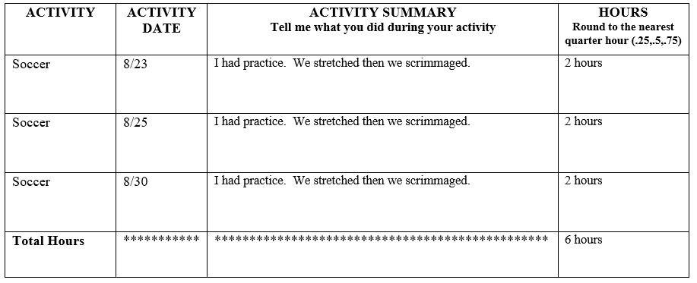
Activity Logs: Examples of Poor Work

Slide 16
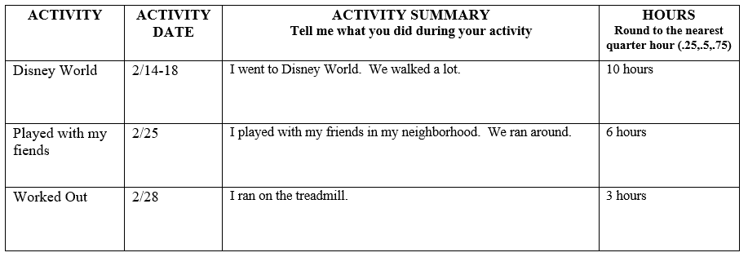
Activity Logs: Examples of Poor Work

Slide 17
Activity Logs How much does not doing an Activity Log effect my grade??
Example 1:
Participation – 100%
Classwork/Homework – 100%
Majors Grades
Test 1 – 100%
Test 2 – 100%
Test 3 – 100%
Activity Log 1 – 100%
Activity Log 2 – 100%
Activity Log 3 – 0%
Quarter Average = 93.3
Example 2:
Participation – 100%
Classwork/Homework – 100%
Majors Grades
Test 1 – 100%
Test 2 – 100%
Test 3 – 100%
Activity Log 1 – 100%
Activity Log 2 – 0%
Activity Log 3 – 0%
Quarter Average = 86.64

